Slide 1
Online Shopping Portal
For
MyCompany.com
Project Code: PRJ-2014/101

Slide 2
Project overview
Initiating
Planning
Controlling
Execution
Closing

Slide 3
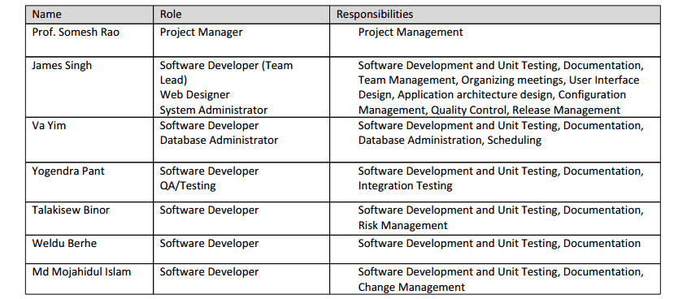
Initiating
Planning
Executing
Controlling
Closing
Team Setup

Slide 4
Initiating
Planning
Executing
Controlling
Closing
Initiating Phase
Defined business case
Feasibility study
Developed project charter
Assigned project management team.

Slide 5
Initiating
Planning
Executing
Controlling
Closing
Scope
Scope
Requirement doc
Functional spec
Define change request
Quality
Time
Cost

Slide 6
Initiating
Planning
Initiating
Planning
Executing
Controlling
Closing
Initiating
Planning
Quality
Configuration Management
(PRJ-2014-101_Configuration_Management_0.0.1)
Status review after every iteration
Quality audit
(at the beginning of 3rd iteration)
Security audit
(At the beginning of 4th iteration)
Scope
Quality
Time
Cost

Slide 7
Initiating
Planning
Executing
Controlling
Closing
Initiating
Planning
Time
Defined phases, iterations and milestones.
Prepared a schedule
Scope
Quality
Time
Cost
Iteration 1
Iteration 2
Iteration 3
Iteration 4
First phase
Second phase
Project period

Slide 8
Initiating
Planning
Executing
Controlling
Closing
Initiating
Planning
First Iteration:
July 7th – July 9th
Second Iteration:
July 10th – July 12th
Third Iteration:
July 13th – July 14th
Fourth Iteration:
July 15th – July 16th
Scope
Quality
Time
Cost

Slide 9
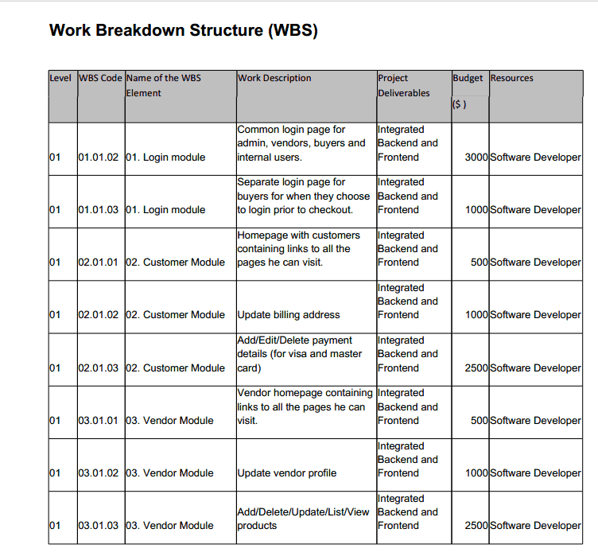
Initiating
Planning
Executing
Controlling
Closing
https://docs.google.com/file/d/0B1bWsZvmMNDNWGozUXRfMVZKaFE/edit

Slide 10
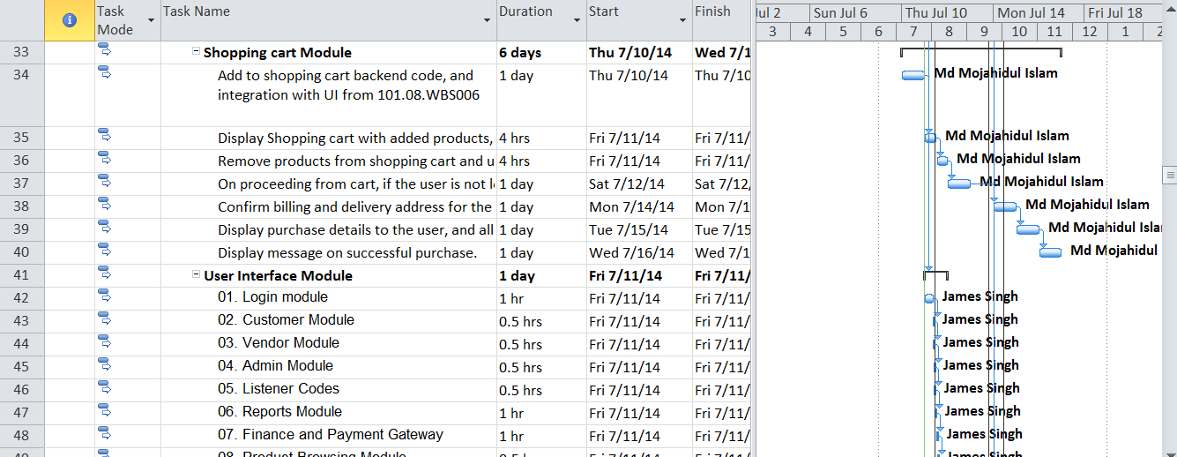
Initiating
Planning
Executing
Controlling
Closing
Work distribution

Slide 11
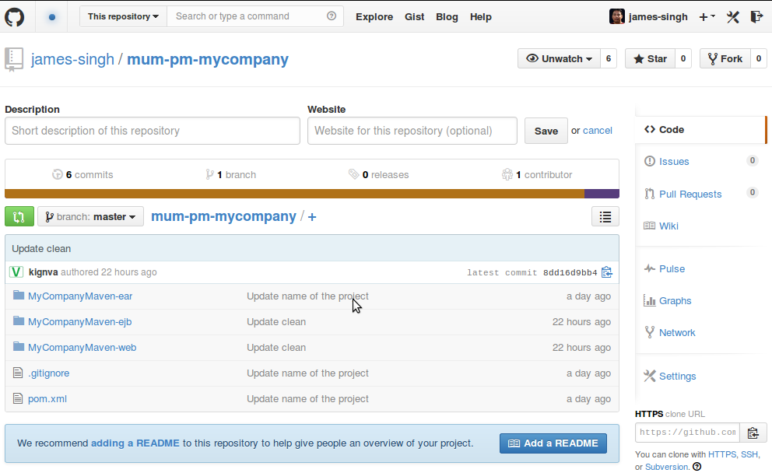
Initiating
Planning
Executing
Controlling
Closing
Collaboration for development

Slide 12
Initiating
Planning
Executing
Controlling
Closing
Development Progress
Infrastructure setup
Database design and implementation
UI layout design
Development status
  Registration and Login (for vendor and buyer)
  Payment Gateway:Credit card for newly registered user.
  Vendor: Add and list products
  Buyer: Browse products, view product detail
  Shopping cart (Remaining)
  Order: Enter billing and shopping address
  Order: Enter credit card details
  Order: Display shopping cart, address and cart details.
  Payment Gateway integration
  MyFinance.com integration

Slide 13
Initiating
Planning
Executing
Controlling
Closing
Quality Control
  CM (Configuration Management) audit
  At the beginning of Iteration 3
  Security Audit
  At the beginning of Iteration 4
  Status review at the end of every iteration.

Slide 14
Initiating
Planning
Executing
Controlling
Closing
Milestones (for controlled progress)
  Milestone 1 – Complete design document
  Milestone 2 – 35% development completion
  Milestone 3 – 85% development completion
  Milestone 4 – 100% development completion

Slide 15
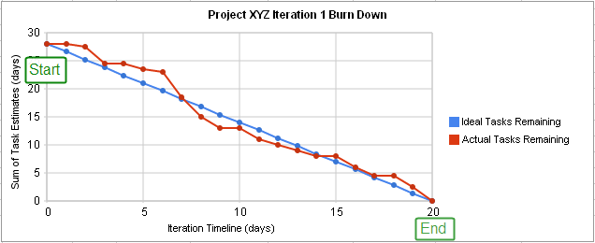
Initiating
Planning
Executing
Controlling
Closing
Burndown chart

Slide 16
Initiating
Planning
Executing
Controlling
Closing
Closing
  Release management
  Production release
  Post-production training

Slide 17
A line of wisdom...
“Highest first”
Proper initial planning of the project leads to quality product and overall success of the project.

Slide 18
Thank you!
Q&A

